Slide 1
CA LAB 8 RTC

Slide 2
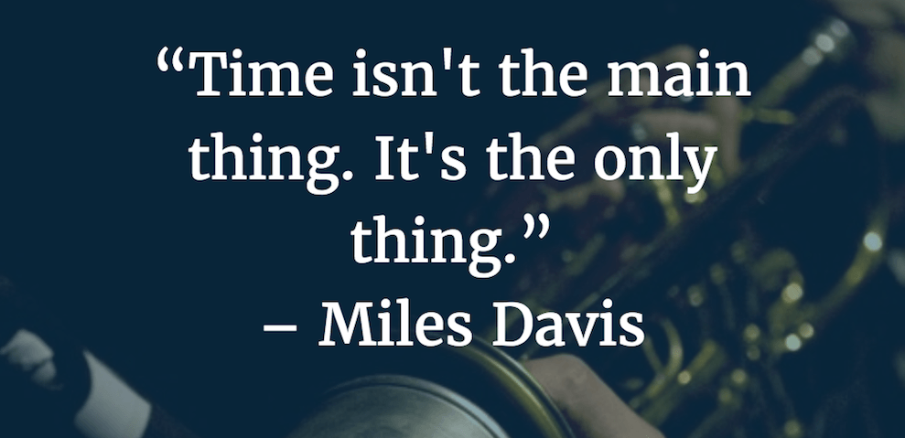

Slide 3
TIME
Time is the indefinite continued progress of existence and events that occur in an apparently irreversible succession from the past, through the present, into the future.
Time in physics is defined by its measurement: time is what a clock reads.
It is a component quantity of various measurements used to sequence events, to compare the duration of events or the intervals between them, and to quantify rates of change of quantities in material reality or in the conscious experience
Time is also referred as fourth dimension.

Slide 4
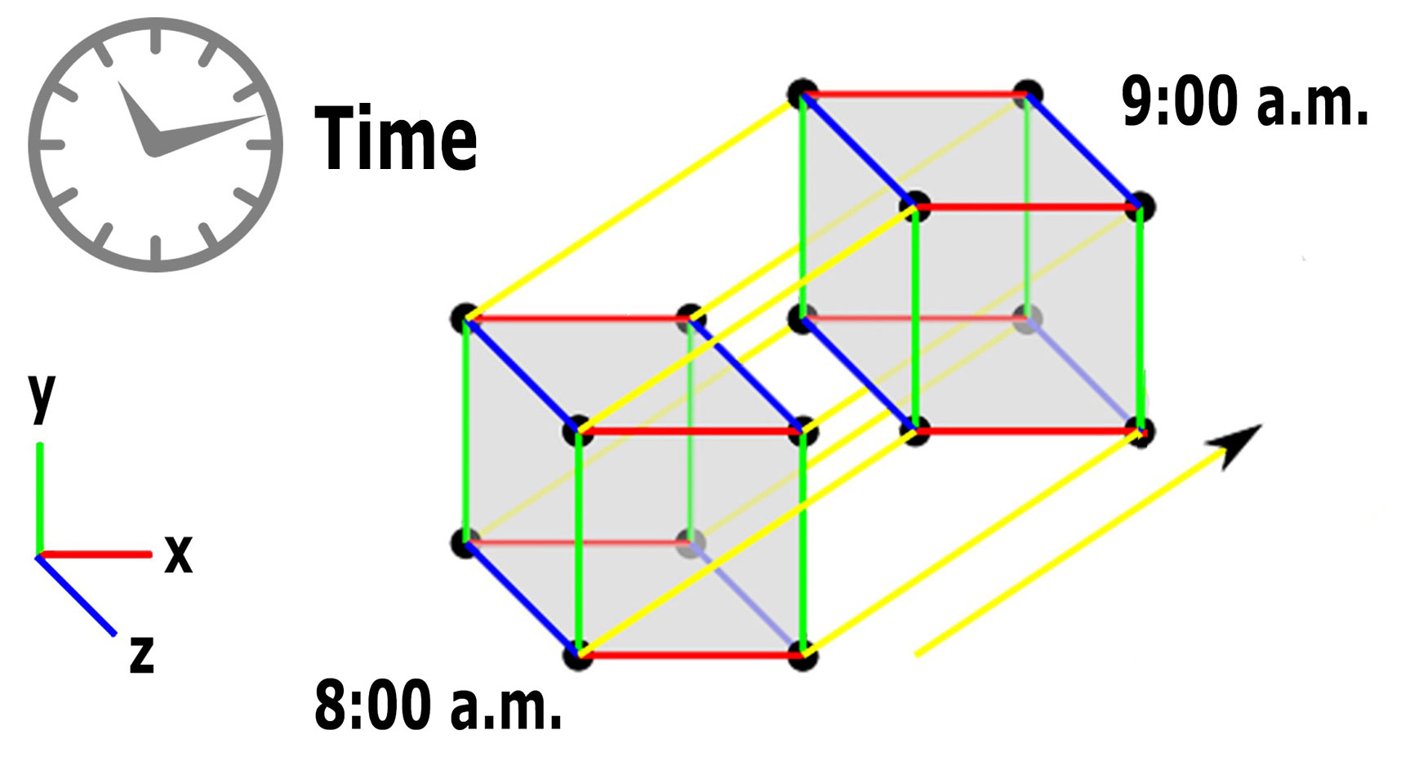
4 Dimension Space & Time

Slide 5


Slide 6
Time Measurement
Physical Quantity
Scalar or Vector
SI unit is Seconds(sec, s)
Time is measured through clocks, calendar
Currently, the international unit of time, the second, is defined by measuring the electronic transition frequency of caesium atoms

Slide 7
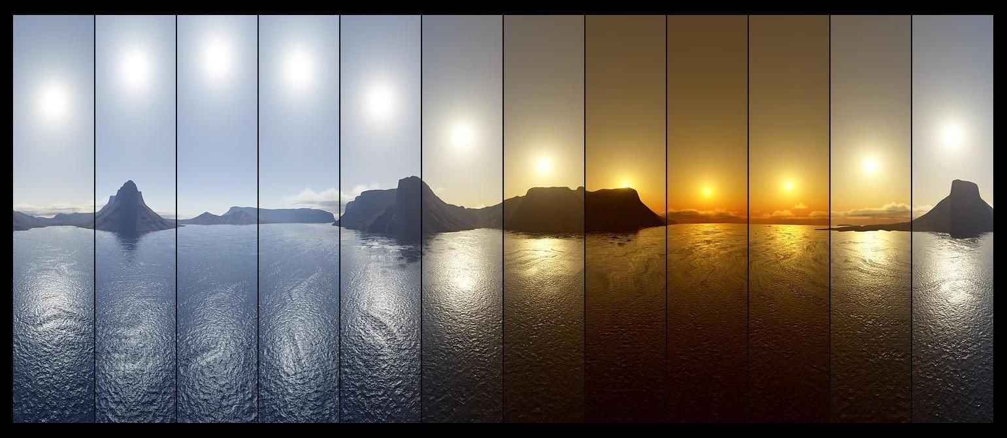
History of Time Measurement

Slide 8
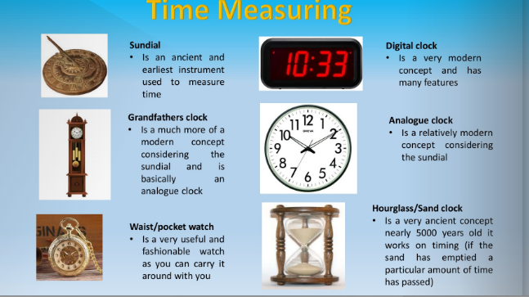

Slide 9
Atomic Clock
Atomic clocks are designed to measure the precise length of a second.
Atomic clocks are the most accurate time and frequency standards known, and are used as primary standards for international time distribution services, to control the wave frequency of television broadcasts, and in global navigation satellite systems such as GPS.

Slide 10
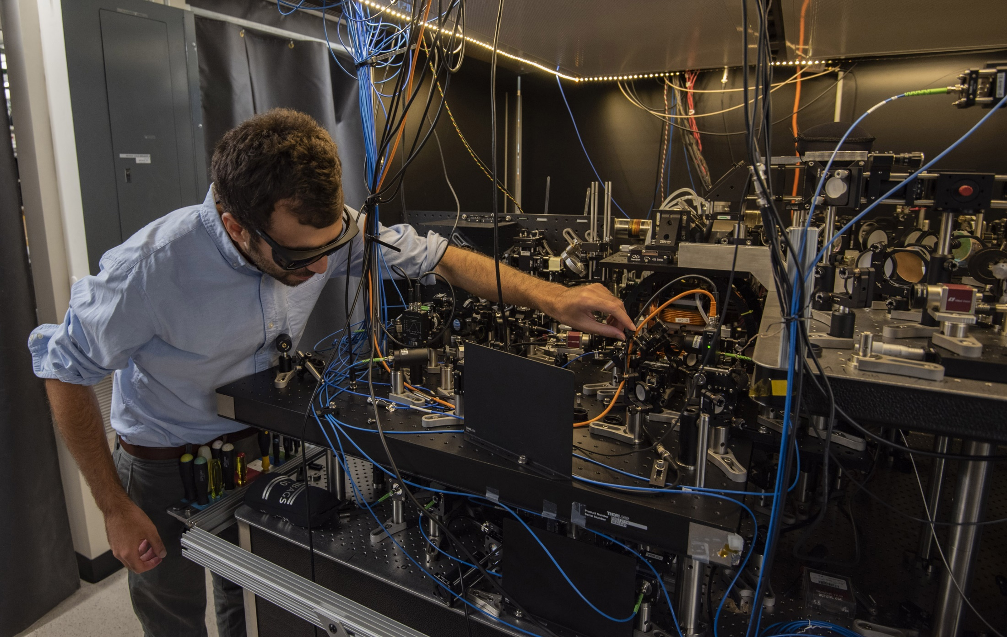

Slide 11
Time Zones
A time zone refers to any region where the same standard time is kept.
We have different time zones in the world.
Universal Time:
Universal Time is a solar time standard that reflects the average speed of the Earth's rotation.

Slide 12
More on Time
Time dilation is a difference in the elapsed time as measured by two clocks due to there existing between them either a relative velocity or a difference in gravitational potential between their locations.
Gravity has an impact on time. The stronger the gravity, the more spacetime curves, and the slower time itself proceeds.
Example: GPS satellites clocks are designed to be slower as compared to ground clocks.

Slide 13

1 Hour on this planet = 7years on earth

Slide 14
Time importance in Electronics & Computers.
When task is performed.
How much time it take.
Time stamp for files.
For automation to perform a task at specific time or interval.
To keep the record.(when request was made or get accepted)
For communication purpose.

Slide 15
RTC (Real Time Clock)
To provide the time information and setting up the time in devices we use RTC (Real Time Clock).
A real-time clock (RTC) is an IC that keeps an updated track of the current time.
This information can be read by a microprocessor, usually over a serial interface to facilitate the software performing functions that are time dependent.
RTCs are designed for ultra-low power consumption as they usually continue running when the main system is powered down.
This enables them to maintain current time against an absolute time reference, usually set by the microprocessor directly.

Slide 16
RTC (Real Time Clock)
They are available as integrated circuits (ICs) and supervise timing like a clock and also operate date like a calendar.
The clock/calendar provides seconds, minutes, hours, day, date, month and year qualified data. The end date of each month is automatically adjusted, especially for months with less than 31 days.
The main advantage of RTC is that they have an arrangement of battery backup which keeps the clock/calendar running even if there is power failure.
An exceptionally little current is required for keeping the RTC animated. (Nano amperes are required).

Slide 17
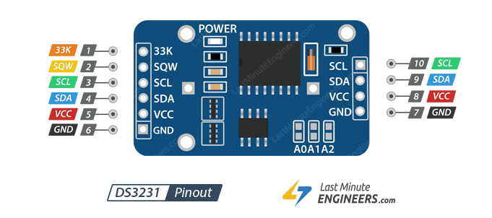
DS3231 RTC Module

Slide 18
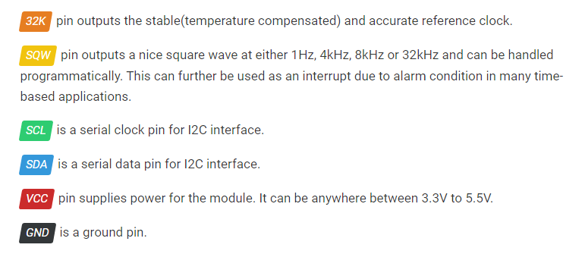
DS3231 RTC Module Pin Configuration

Slide 19
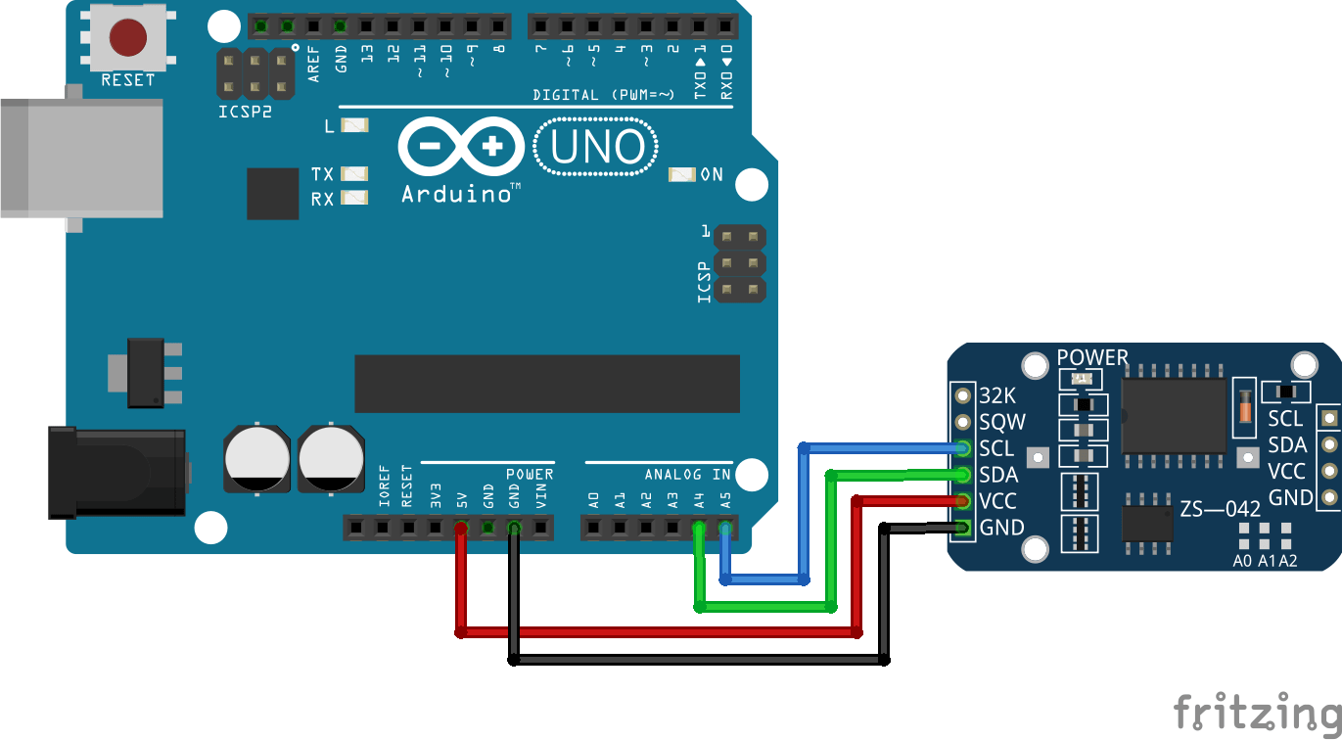
DS3231 RTC Module Connection with Arduino

Slide 20
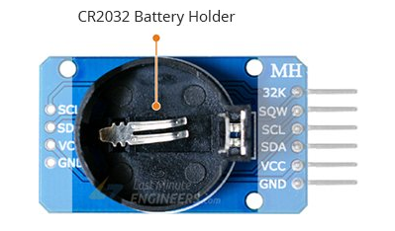
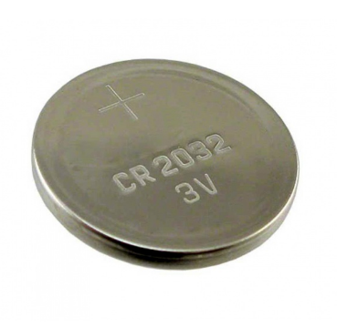
DS3231 RTC Module

Slide 21
Map Function
Re-maps a number from one range to another. That is, a value of fromLow would get mapped to toLow, a value of fromHigh to toHigh, values in-between to values in-between, etc. Syntax map(value, fromLow, fromHigh, toLow, toHigh) value: the number to map. fromLow: the lower bound of the value’s current range. fromHigh: the upper bound of the value’s current range. toLow: the lower bound of the value’s target range. toHigh: the upper bound of the value’s target range.

